Slide 2




$$\hat{v}$$
A
A
$$ρ$$
$$\hat{v}$$
$$ρ$$

Slide 3









P
P
P (dB)
DR_{P}
DR_{T}
DR_{I}
t
t
t
$$p_{1}$$
$$Z_{1}, c_{1}$$
$$Z_{2}, c_{2}$$
DR_{P}
$$Z_{1}, c_{1}, α_{1}$$
$$θ_{11}$$
DR_{I}
$$θ_{21}$$
$$θ_{12}$$
$${p_{3}=TF p}_{1}$$
$${p_{2}= RF p}_{1}$$

Slide 4
Matching Layer
Bulk Piezoelectric
+
V_{RF}
-
Matching Layer
Membrane
Matching Layer
+
Deflection
Piezoelectric Layer
V_{RF}
+
-
V_{RF}
Dielectric
-
Deflection
Cavity
Insulation
Cavity
Sillicon Substrate
Substrate

Slide 5
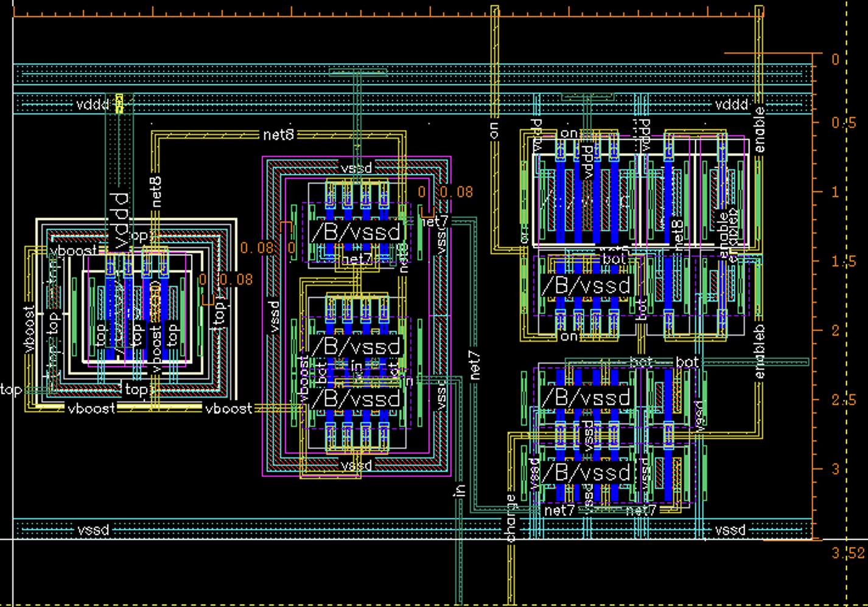
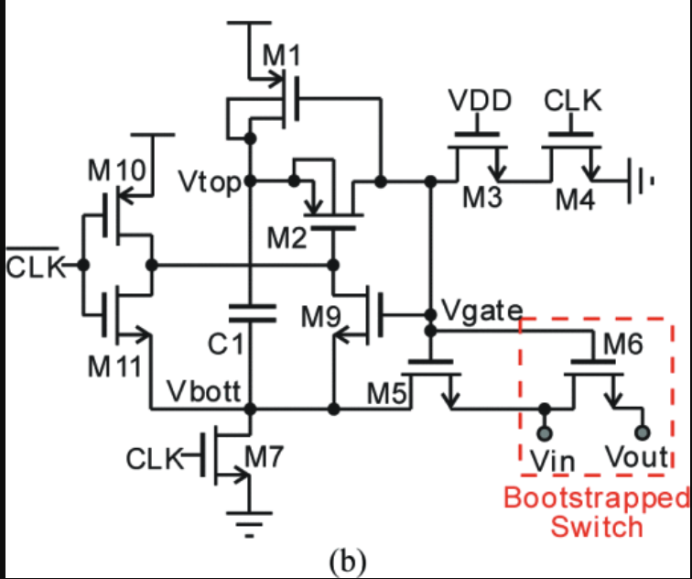
A
B
vboost
A
vin
B

